Slide 1


Lecture 14:
Concurrent and Parallel Programming
CoTaPP: Computational Thinking and
Programming with Python
All icons by: https://www.flaticon.com/

Slide 2

Exam Review
Friday, 1 April, 10:00 – 12:00
Online
Check exam: Remindo
Questions? On Teams

Slide 3
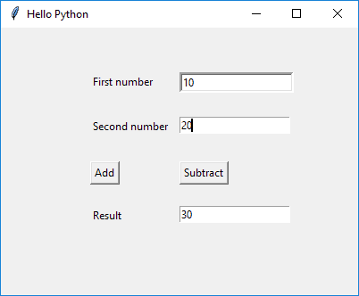


Previous lecture

Slide 4
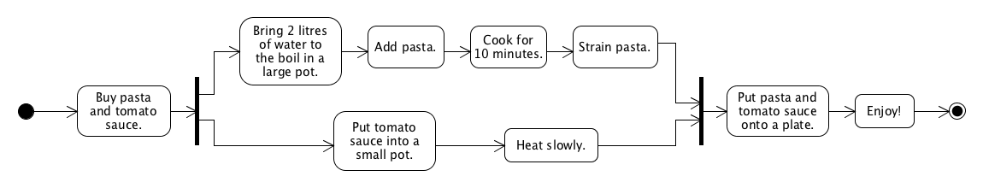
Today

Slide 5
Parallel Programming

Slide 6
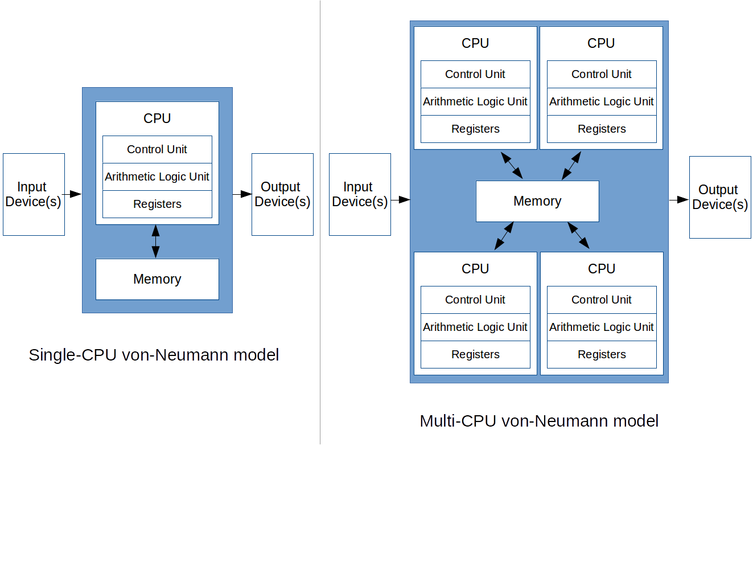
Von Neumann Model

Slide 7
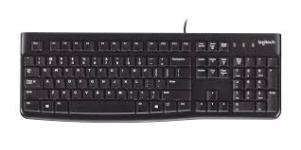



Von Neumann Model

Slide 8
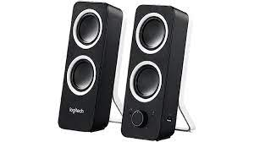
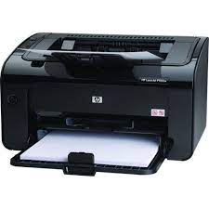

Von Neumann Model

Slide 9
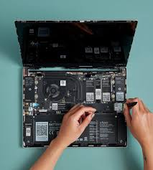

Von Neumann Model

Slide 10
Von Neumann Model

Slide 11
Concurrency

Slide 12

Concurrency

Slide 13

Concurrency

Slide 14

Concurrency

Slide 15

Concurrency

Slide 16

Concurrency

Slide 17
Parallelism

Slide 18

The coffee house

Slide 19
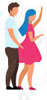
The coffee house

Slide 20
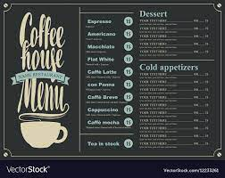
The coffee house

Slide 21
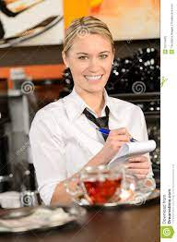
The coffee house

Slide 22
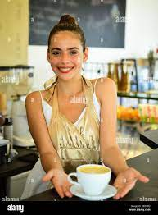
The coffee house

Slide 23
The coffee house

Slide 24
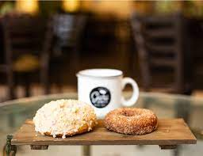
The coffee house

Slide 25
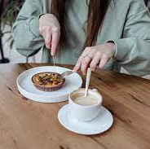
The coffee house

Slide 26
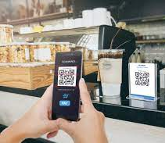
The coffee house

Slide 27

The coffee house

Slide 28
The coffee house

Slide 29
The coffee house

Slide 30
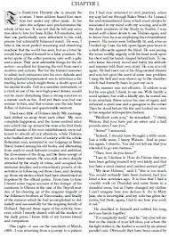
Text search
Longest word
Most frequent word
Number of palindromes
deed
rotator

Slide 31
Concurrency

Slide 32
Concurrency

Slide 33
Concurrency

Slide 34


Concurrency?
Longest word
Most frequent word
Number of palindromes

Slide 35
Parallelism
Longest word
Most frequent word
Number of palindromes

Slide 36

Aan de slag

Slide 37
To Do
Exercises for the week
  Use Quarterfall to submit them
Start Project 4
Practice practice practice!
Ask questions!

